Slide 1
Palmdale School District
Wellness Session
July 15, 2022
Connecting culturally responsive, trauma-informed education to everyday practice.

Slide 2
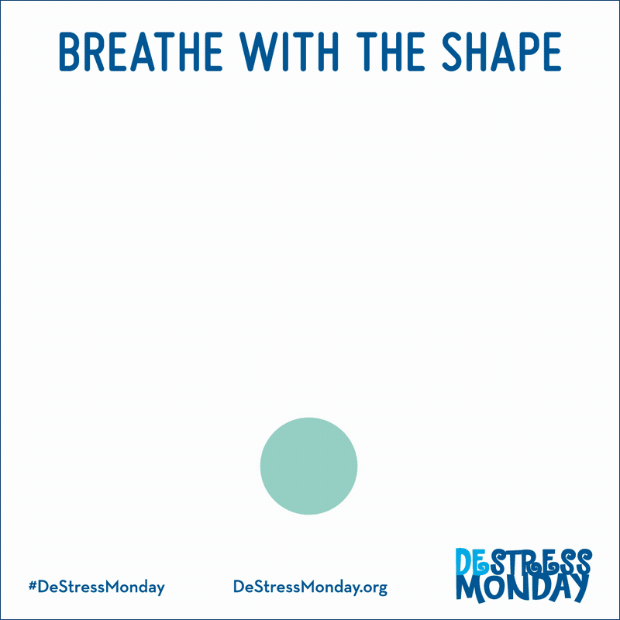
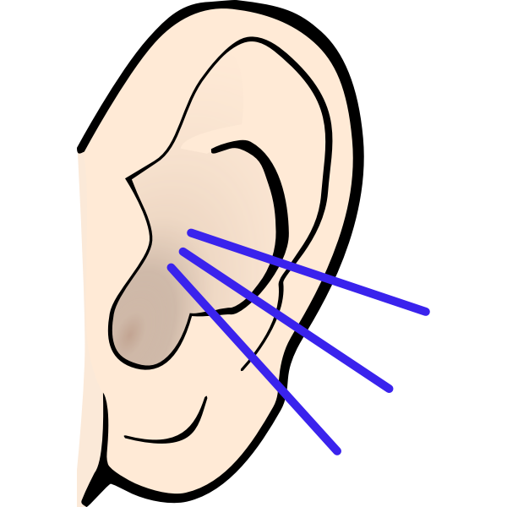
Grounding Technique. Ease your mind.
Acknowledge 5 things that you can see around you.
Acknowledge 4 things that you can touch around you.
Acknowledge 3 things that you can hear around you.
Acknowledge 2 things that you can smell around you.
Acknowledge 1 things that you can taste around you.

Slide 3
The People Who Support Me
Write down the names of one or two people to whom you turn when you feel stressed or upset.
Write down three to five positive qualities that are common to these people.
Recall a specific situation in which you felt worried or upset this past month and one of these people helped you. TEXT or EMAIL them and thank them for their support.

Slide 4
About Me

Slide 5
Strategic Goals:
Provide strategic direction and support to district administrators, principals, teachers, and sites focused on improving the quality of classroom instruction and interaction in every classroom in every school.
Goals for the session:
Understand symptoms and effects of compassion fatigue and fatigue risk factors
To learn about practices related to school connectedness
To discuss the practice implications and recommendations that could help improve educators’ wellbeing and resilience

Slide 6
Awareness
Bringing awareness to ourselves through self-inquiry, reflection, mindfulness, and noticing unearths the ways in which our body is handling stress and responding to trauma.
Compassion
Compassion - being kind to ourselves, engaging, in positive self-talk, and practicing self-care helps us develop a deeper resilience.
Connection
Being seen, known, heard, and understood by others is essential to feeling connected; when we have a sense of belonging, we feel accepted, valued, and affirmed by our community.
Agency
Managing our behavior, emotions, and motivation takes practice, and with that practices comes a deep sense of our own power and strength; we call that agency.

Slide 7
Awareness
Bringing awareness to ourselves through self-inquiry, reflection, mindfulness, and noticing unearths the ways in which our body is handling stress and responding to trauma.
Compassion
Compassion - being kind to ourselves, engaging, in positive self-talk, and practicing self-care helps us develop a deeper resilience.
Connection
Being seen, known, heard, and understood by others is essential to feeling connected; when we have a sense of belonging, we feel accepted, valued, and affirmed by our community.
Agency
Managing our behavior, emotions, and motivation takes practice, and with that practices comes a deep sense of our own power and strength; we call that agency.

Slide 9
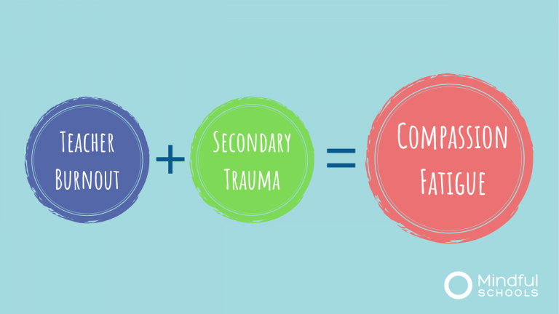
What is compassion fatigue?
Notes:
Compassion fatigue is the mental, physical, and emotional exhaustion that comes with working people who are in constant states of distress or trauma (Lerias & Byrne, 2003).
Left unaddressed it can cause extreme mental and physical health challenges (Figley, 1995).
Stamm (2010), conceptualized compassion fatigue as a combination of secondary trauma and burnout.

Slide 10
What is compassion fatigue?
COMPASSION FATIGUE IS A SET OF SYMPTOMS, NOT A DISEASE.
Notes:
Compassion fatigue is the mental, physical, and emotional exhaustion that comes with working people who are in constant states of distress or trauma (Lerias & Byrne, 2003).
Left unaddressed it can cause extreme mental and physical health challenges (Figley, 1995).
Stamm (2010), conceptualized compassion fatigue as a combination of secondary trauma and burnout.

Slide 11
Primary Trauma
Secondary Trauma
Vicarious Trauma
You are in harm's way or danger; grief
Bearing witness to the suffering of others; listening to stories; seeing evidence, pictures, videos; caring for survivors; comforting the grieving
Shifts our world view, as a result of secondary trauma

Slide 12
Who is affected by Compassion Fatigue?
Everyone can be.
It’s the cost of caring.

Slide 13
Round 1:
What new insights did you glean about yourself from the survey?

Slide 14
Round 2:
What type of social emotional skills or strategies do you model for your staff, students, or families?

Slide 15
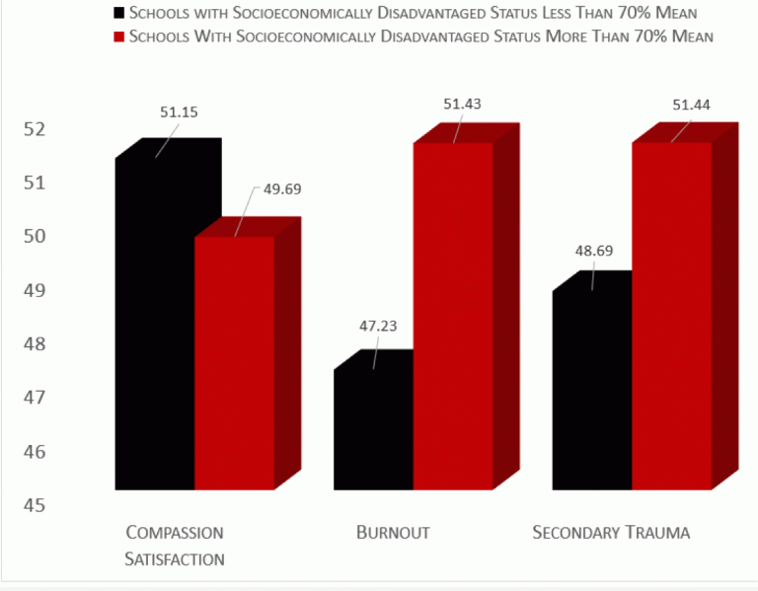
Notes:
The Professional Quality of Life Scale, version 5 (ProQOL5) was administered to teachers throughout the state of California, and subsequent follow-up interviews were conducted (Stamm, 2010).
The ProQOL 5 measures compassion fatigue in two parts – burnout and secondary trauma, and compassion satisfaction. Compassion satisfaction is the joy one experiences from their work.
The sample pool of 100 teachers-participants contained 35% of elementary school teachers, 24% of middle school teachers, 37% of high school teachers.

Slide 16
Findings
Female teachers experience more Compassion Fatigue than male teachers.
Compassion Fatigue is more acute with beginning teachers than with veteran teachers.
Teachers working at high poverty schools experience statistically significant differences in compassion satisfaction and fatigue than teachers at low poverty schools. They experience less compassion satisfaction, higher burnout, and higher secondary traumatic stress.
Secondary trauma from students is not the only trauma teachers are experiencing. Trauma is school-conditions- and climate- based. Parents or school site administration are sometimes the cause. Common threads amongst all interviews were the implication that school administrators do not always understand the teacher’s everyday classroom experience and that parents sometimes feel like an adversary, even though they are not supposed to be.
School climate and conditions matter. Teachers have concerns about how actions taken by school environment actors including parents, students, other teachers, and administrators affect their ability to create safe and academically challenging environments. Teacher morale is often affected by how students are treated or how students are treating them.

Slide 17
Given that 60% of California’s 6.2 million students live in poverty, 73% of its teachers are female, and newer teachers are often the ones hired to work in understaffed urban schools, we have a big challenge on our hands.

Slide 18
Compassionate responses and policies that genuinely make a difference in the life of teachers and students should be implemented at the school, district, county, and state levels.

Slide 19
Increase your
Visibility
Schedule Listening Tours
Normalize Classroom Visits
Build a Culture of Feedback
Encourage and Model Wellness
Think Small
How To Lead With Empathy?

Slide 20
Compassionate Responses and Policies
Compassion Resilience Toolkit for School Leaders and Staff
How To Lead With Empathy
8 Examples of Compassion Activities for Elementary Students
The Wellness Compass

Slide 21
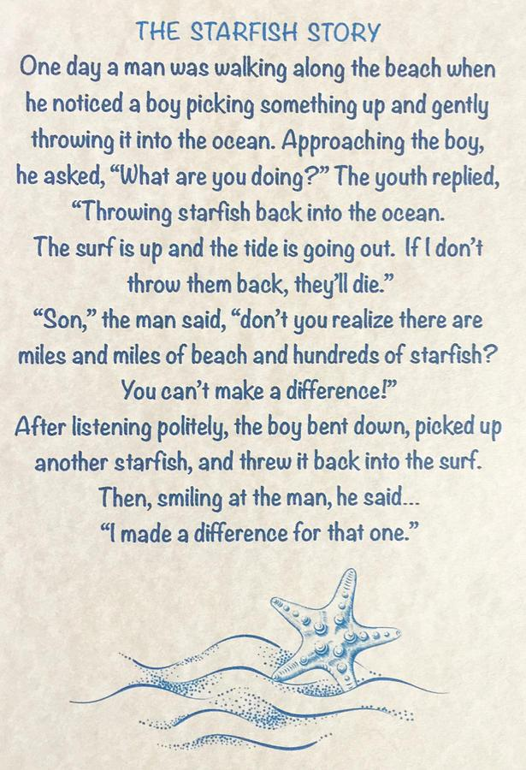
Learning in Community
One thing I'm taking with me from today is...
One thing I appreciate about today is..
One thing I commit to based on what we discussed today is...

Slide 22
Resources
https://www.mindfulschools.org/inspiration/compassion-fatigue-how-california-can-improve-teacher-retention/
Improving Teacher Retention by Addressing Teachers’ Compassion Fatigue.

Slide 23
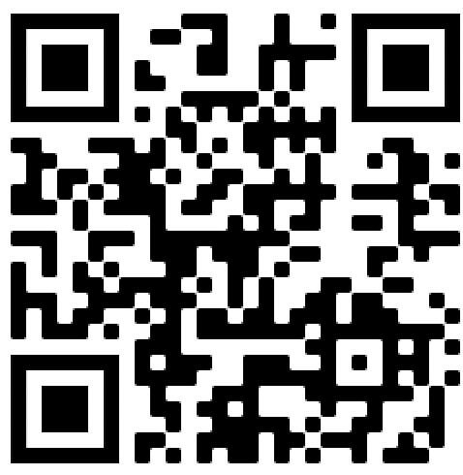
Let’s stay connectED!
connectedcoachingconsulting.com

